Slide 1
CISC106 – i>clicker
What will be output?
y = 0
y = 1
y = y
None
An error will occur
x = 5
y = 0
if not x > y:
y = 1
print('y =', y)

Slide 2
CISC106 – i>clicker
What will be output?
y = 0
y = 1
y = y
None
An error will occur
x = 5
y = 0
if not x > y:
y = 1
print('y =', y)

Slide 3
CISC106 – i>clicker
The variable z in function double() is called a(n)?
local variable
global variable
ephemeral variable
cypher
list
def double(x):
z = x * 2.0
return z
x = double(5)
print(x)

Slide 4
CISC106 – i>clicker
The variable z in function double() is called a(n)?
local variable
global variable
ephemeral variable
cypher
list
def double(x):
z = x * 2.0
return z
x = double(5)
print(x)

Slide 5
CISC106 – i>clicker
This code is an example of what?
Compound boolean expressions
Input testing
Output testing
Parameter testing
All of the above
x = int(input('Enter a positive int: '))
while x <= 0:
print(x, 'is not a positive int'):
x = int(input('Enter a positive int: '))

Slide 6
CISC106 – i>clicker
This code is an example of what?
Compound boolean expressions
Input testing
Output testing
Parameter testing
All of the above
x = int(input('Enter a positive int: '))
while x <= 0:
print(x, 'is not a positive int'):
x = int(input('Enter a positive int: '))

Slide 7
CISC106 – i>clicker
This code shows an example of what?
Compound boolean expressions
Input testing
Output testing
Parameter testing
All of the above
def square_root(x):
if x < 0:
print(x, 'must be non-negative')
return None
return x ** 0.5

Slide 8
CISC106 – i>clicker
This code shows an example of what?
Compound boolean expressions
Input testing
Output testing
Parameter testing
All of the above
def square_root(x):
if x < 0:
print(x, 'must be non-negative')
return None
return x ** 0.5

Slide 9
CISC106 – i>clicker
In Python, this type of object is called a(n):
array
list
mess
series
sequence
[0, 'one', True, [x, None]]

Slide 10
CISC106 – i>clicker
In Python, this type of object is called a(n):
array
list
mess
series
sequence
[0, 'one', True, [x, None]]

Slide 11
Format of a for Statement
for <variable> in <List>:
<python statement>
<python statement>
<python statement>
.
.
.
e.g.
for n in [1, 2, 3, 4, 5]:
print(n)
Body

Slide 12
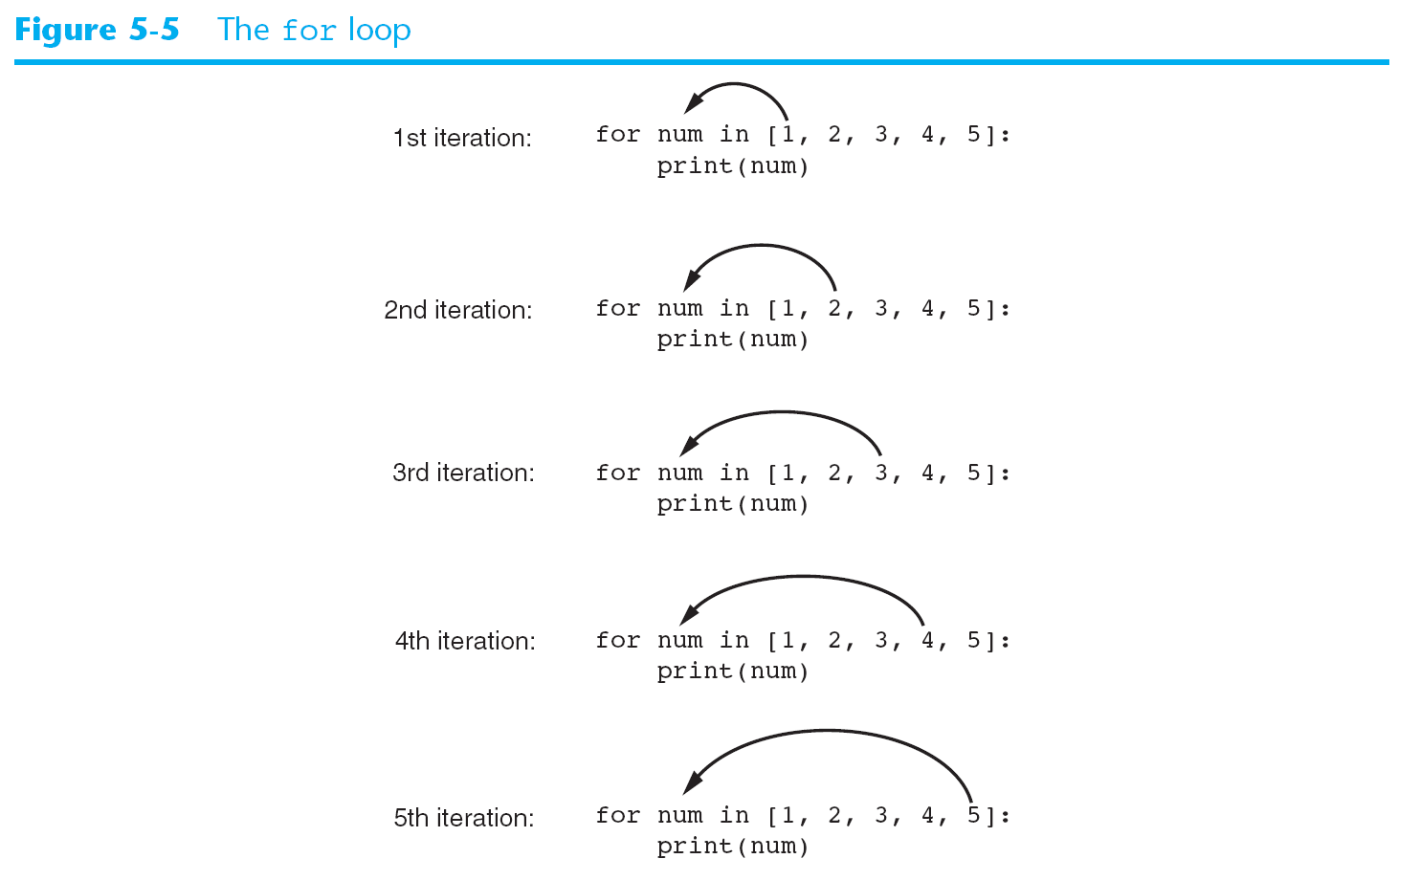

Slide 13
Print a Fahrenheit to Celsius Conversion Table (Assume the function convert_F_to_C() exists)
°F °C
-------------------------------
0 -17.8
10 -12.2
20 -6.7
30 -1.1
40 4.4
50 10.0
60 15.6
70 21.1
80 26.7
90 32.2
100 37.8

Slide 14
The range() function
Think of range() as a convenient way to create a list of ints.
Range(start, stop, step)
Examples:
range(0, 10, 1) = [0, 1, 2, 3, 4, 5, 6, 7, 8, 9]
range(0, 10) = [0, 1, 2, 3, 4, 5, 6, 7, 8, 9]
range(10) = [0, 1, 2, 3, 4, 5, 6, 7, 8, 9]
range(0, 10, 2) = [0, 2, 4, 6, 8]
range(3, -10, -3) = [3, 0, -3, -6, -9]
N.B. The Stop value is NOT included!!

Slide 15
Format of a for Statement using range()
for <variable> in range(start, stop, step):
<python statement>
<python statement>
<python statement>
.
.
.
e.g.
for num in range(1, 6, 1):
print(num)
Which equates to:
for num in [1, 2, 3, 4, 5]:
print(num)
Body

Slide 16
Puzzle
Write Python code to compute (and print) the following summation:
100 + 105 + 110
answer:
x = 100 + 105 + 110
print (x)

Slide 17
Puzzle – Programming an "accumulator"
Write Python code to compute (and print) the following summation:
100 + 105 + 110 + 115 + ... + 500000
answer:
total = 0
for n in range(100, 500005, 5):
total = total + n
print (total)

Slide 18
Puzzle (hard)
A child saves 1 penny on day 1, then adds 2 pennies on day 2, then adds 4 pennies on day 3, then 8 pennies on day 4, ...
How much will the child have saved after 30 days?
Hint: number of pennies saved is:
2⁰ + 2¹ + 2² + 2³ + 2⁴ + ... + 2²⁹
Answer:
total = 0
for n in range(0, 30, 1):
total = total + 2 ** n

Slide 19
for loop – while loop equivalence
for variable in range(start, stop, step):
-------------
-------------
-------------
body
variable = start
while variable < stop:
--------------
--------------
--------------
variable = variable + step
new body

Slide 20
Random Numbers
from random import *
randint(n1, n2) = random integer in [n1, n2]
randrange(n1, n2, n3) = random integer in range(n1, n2, n3)
random() = random float in [0.0, 1.0) (uniform distribution)
uniform(n1, n2) = random float in [n1, n2) or [n1, n2]
= n1 + (n2 – n1) * random()
seed(n) – sets seed used to generate “random” numbers
import random
random.randint(), random.randrange(), random.random(), random.uniform(), random.seed()

Slide 21
Midterm Exam
Chapters 1-5
Material from lectures
Lab 1, Lab 2, Program 1
75 minutes – closed books, notes, neighbor
You may bring a single page (one side), of notes to refer to during the exam. It will be collected with your exam.
No electronic devices permitted (or needed)
Bring pencils and an eraser.

Slide 22
Midterm Exam (cont.)
Some questions will require you to write Python code.
Many can be answered with 1 – 3 lines of code.
There will be at least one problem that requires a more significant amount of code.
You do not need to memorize the rules for precedence or associativity, but you need to be able to apply them.
Any syntax errors on the exam are unintentional. Please notify me at once if you find one.

